Slide 1

It is very important that you stay as still as possible
during the experiment in the MRI machine.
.
If you need to move a bit or stretch, please do so between runs, when the scanner is not running.

Slide 2
Welcome The following presentation will guide you through how to respond to our rating scales.

Slide 3
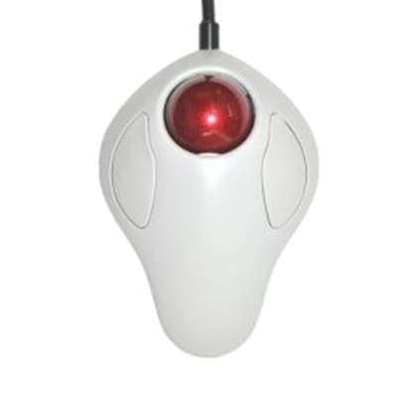
You have been given a trackball or an alternative response device in your dominant hand.

Slide 4

Spinning the trackball to the right will move rating indicators to the right-side of the scale, typically indicating an increase in your rating.

Slide 5
Spinning the trackball to the left will move rating indicators to the left-side of the scale, typically indicating a decrease in your rating.

Slide 6
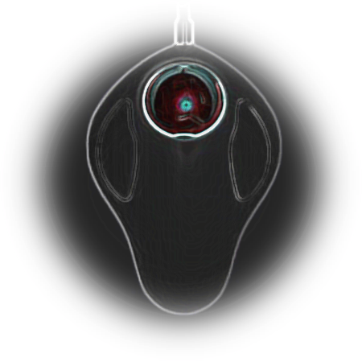
You may submit your response using the left button. Do not use the right button to submit a response.

Slide 7

What to Expect
How intense was this overall?
No Sensation: “I feel no sensation at all.”
Barely Detectable: “I could barely detect this sensation.”
Weak: “I feel that this sensation was weak.”
Moderate: “I feel that this sensation was moderate.”
Strong: “I feel that this sensation was intense.”
Very Strong: “I feel that this sensation was very intense.”
Strongest Imaginable Sensation of Any Kind: “This sensation was so intense that it is the worst I have ever experienced.”

Slide 8

This is an example of a scale rating comfort.
Once in the scanner you can use the trackball to resize the triangle and click to submit your rating.

Slide 9
Could you explain back to me how you understand the rating scale?

